Slide 1
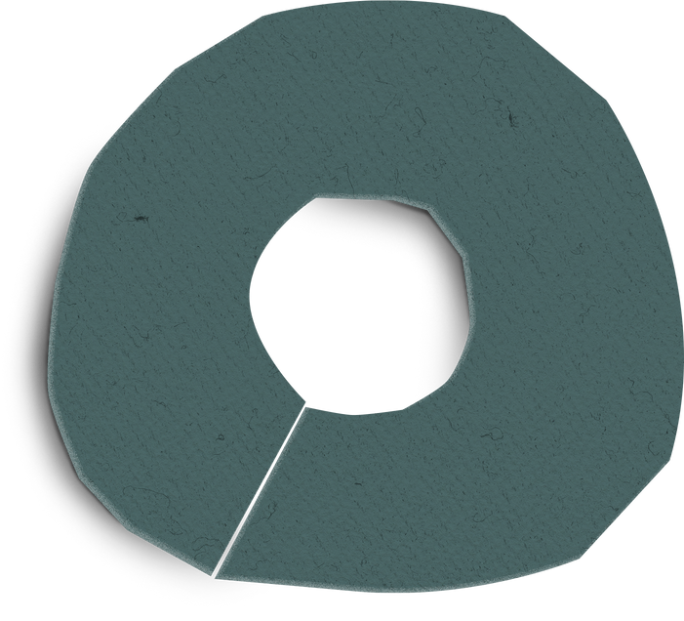
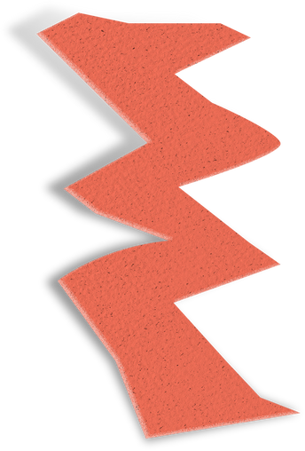
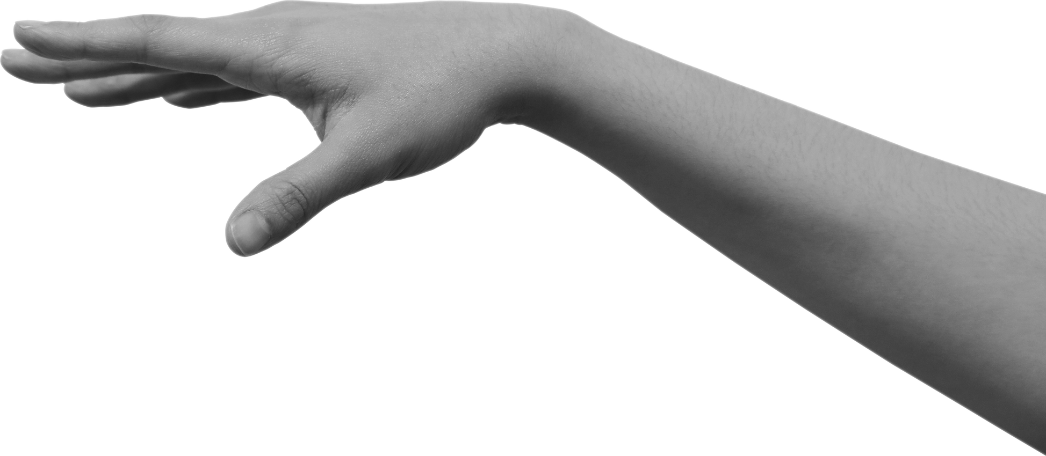
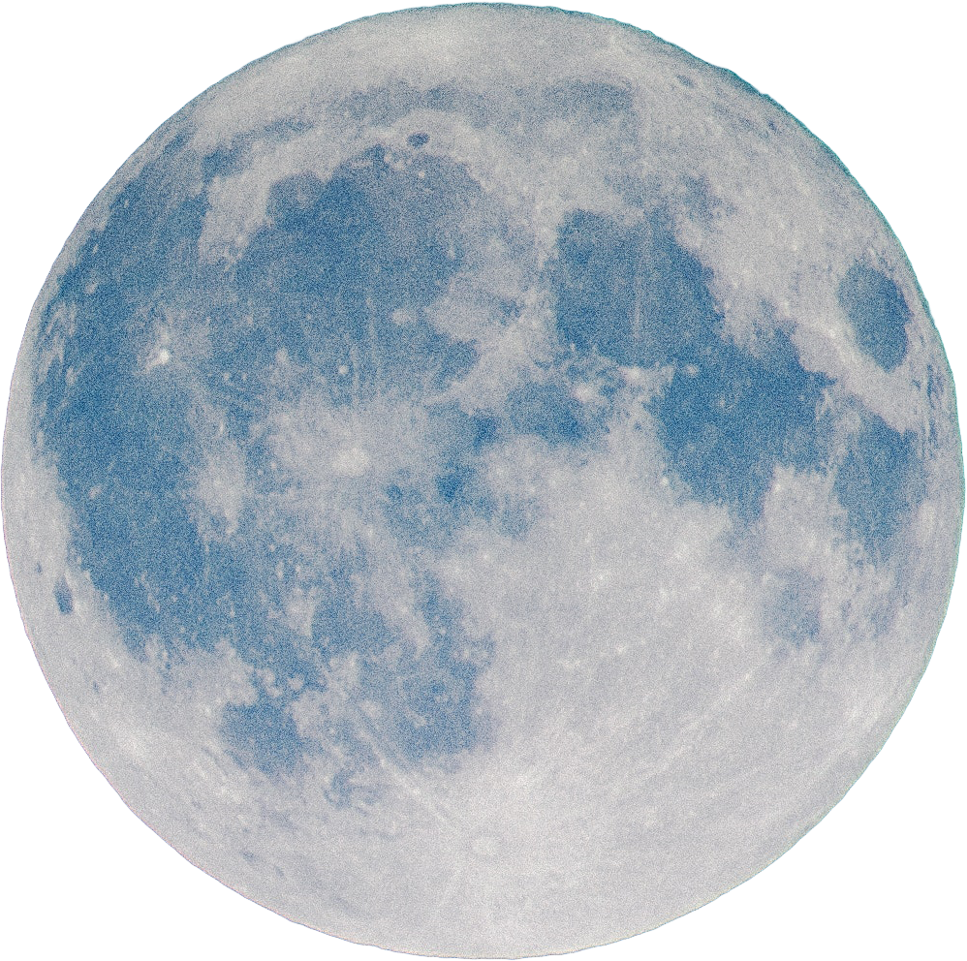


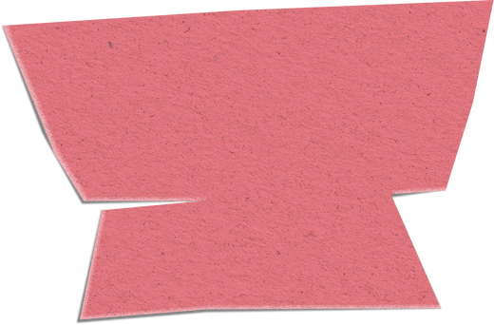
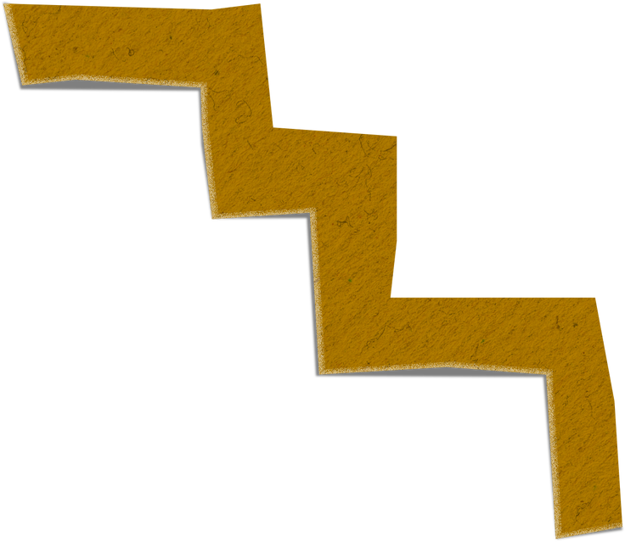
3D DIGITAL TWIN SMART GREENHOUSE
IOT MONITORING & CONTROL SYSTEM

Slide 2
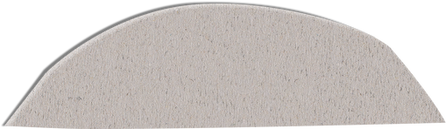
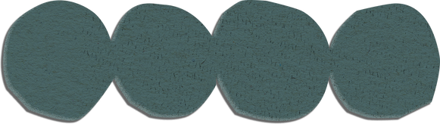
COMP 4270 — Internet of Things
Team: Arshit, Manpreet, Rafid, Ravjeet
Instructor: Dr. Anthony Aighobahi

Slide 3
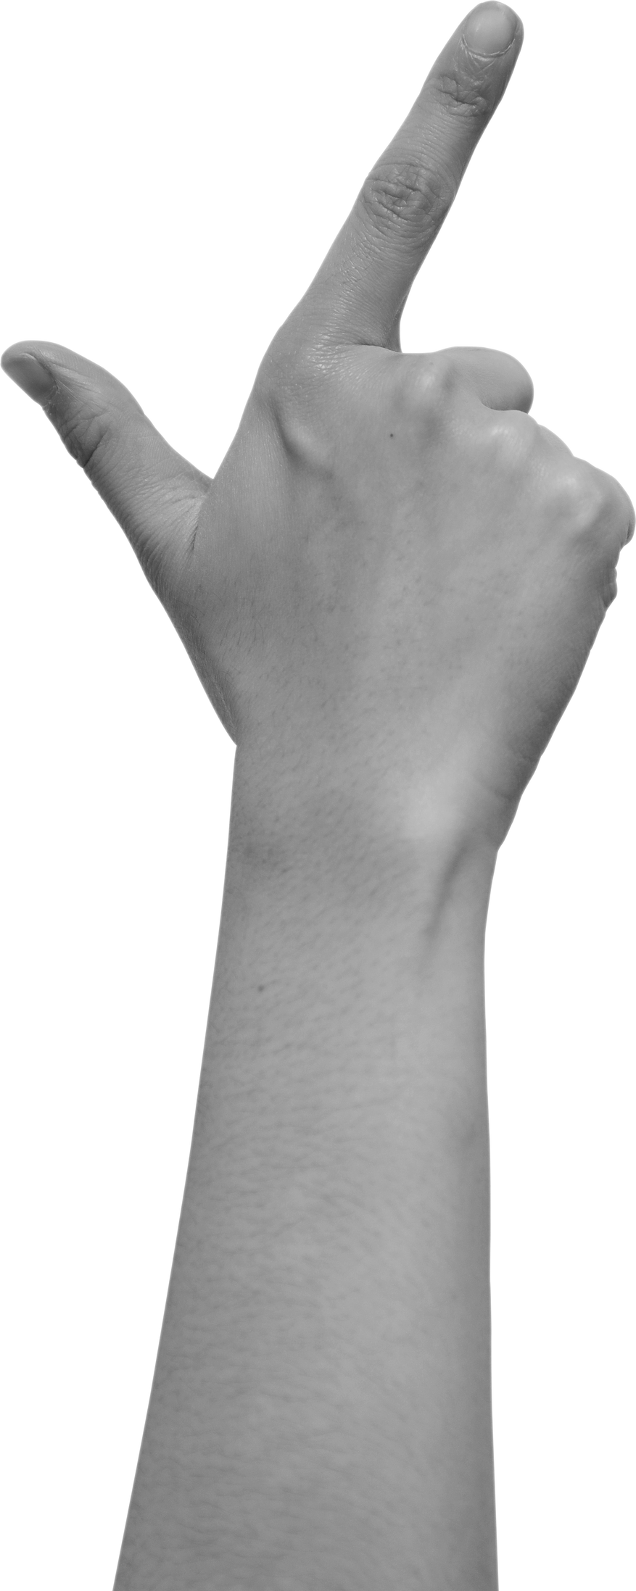
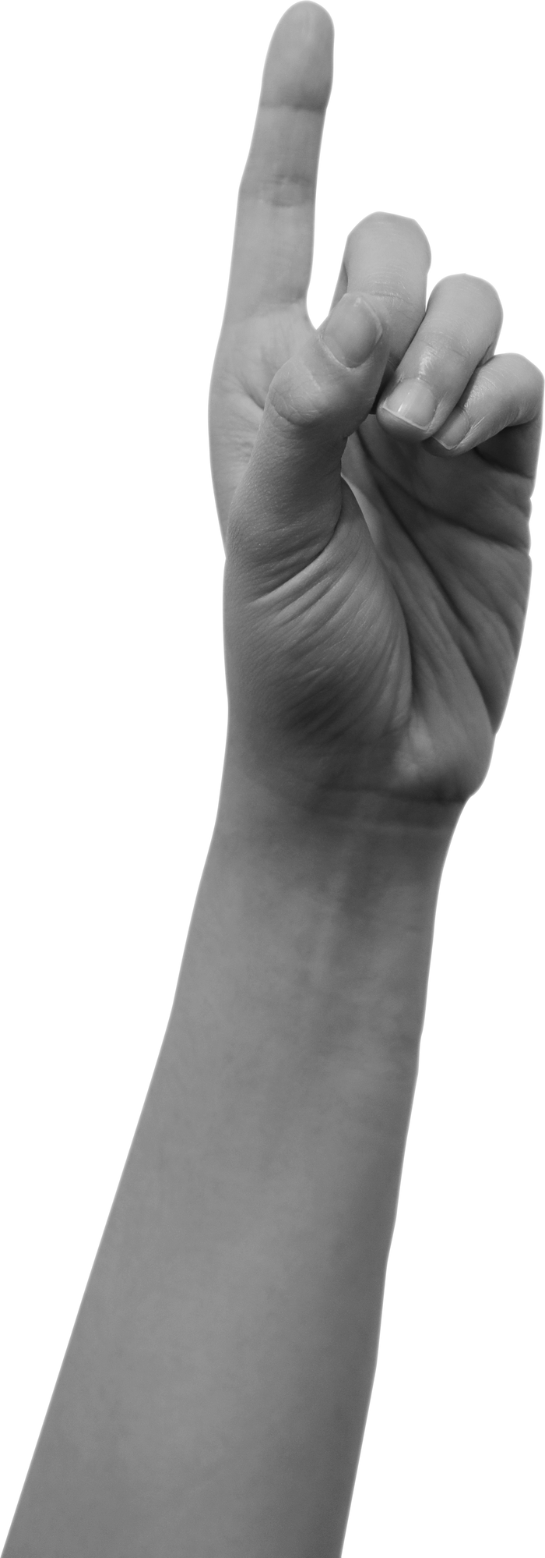

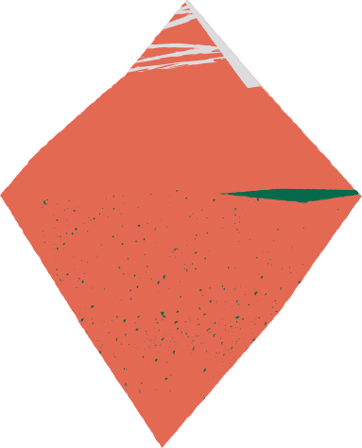
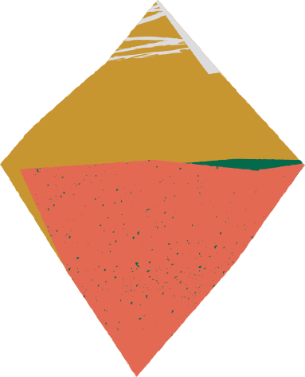
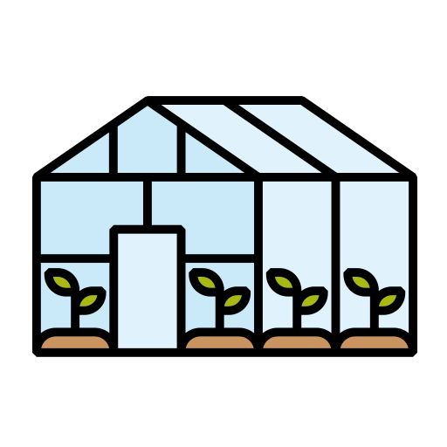
THE GOAL
To make greenhouse gardening fun and accesible
Build a real-time IoT greenhouse system with a 3D digital twin for monitoring and control

Slide 4
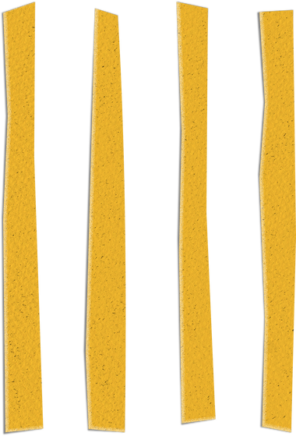
BUT FIRST, THE RESEARCH
PAPER 1 (IOT + ARDUINO):
PAPER 2 (DIGITAL TWIN):
Title: IoT and Arduino Based Design of a Solar, Automated and Smart Greenhouse System (Nouadjep et al., 2022) E3S Conferences
Key idea: Uses Arduino, sensors, and solar power to build an automated greenhouse that optimizes water use and controls the environment.
Strengths: Focus on energy-efficient, autonomous greenhouse with microcontroller control.
Limitations (compared to our project):
No Firebase cloud backend or modern web dashboard with charts.
No interactive 3D digital twin connecting hardware and virtual controls.
Title: Greenhouse Industry 4.0 – Digital Twin Technology for Greenhouse Production Systems (Howard et al., 2021) SpringerLink
Key idea: Proposes an Industry 4.0 digital twin platform that combines IoT, AI, cloud, and big data to optimize large-scale greenhouse production.
Strengths:
Strong focus on scalability, optimization, and analytics.
Shows digital twin as a powerful tool for industrial-level greenhouses.
Limitations:
Heavy architecture, difficult to reproduce in a small lab or student project.
More conceptual; not a simple end-to-end example with Arduino + Unity 3D that can be rebuilt easily.
https://www.e3s-conferences.org/articles/e3sconf/pdf/2022/21/e3sconf_enrconf2021_01002.pdf
https://link.springer.com/article/10.1186/s42162-021-00161-9

Slide 5
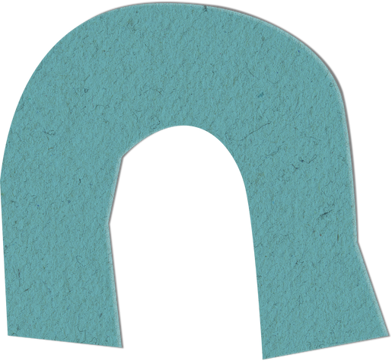
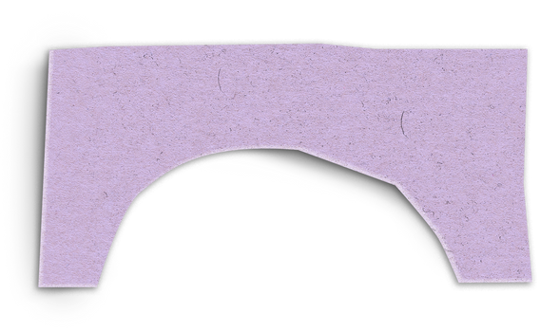

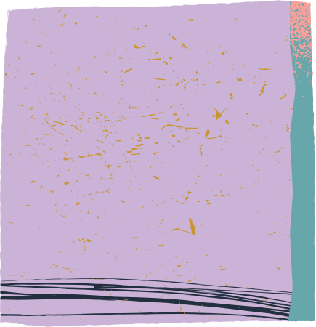
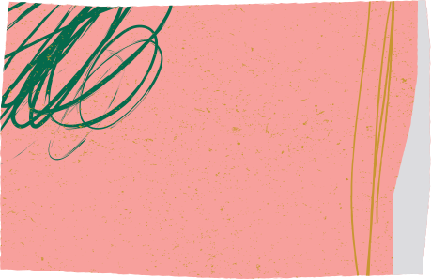

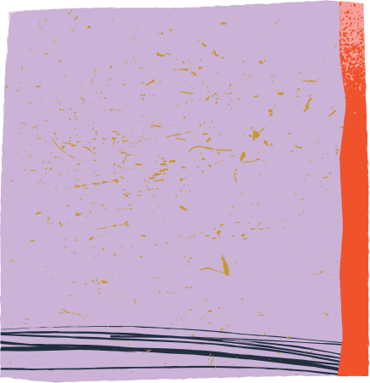
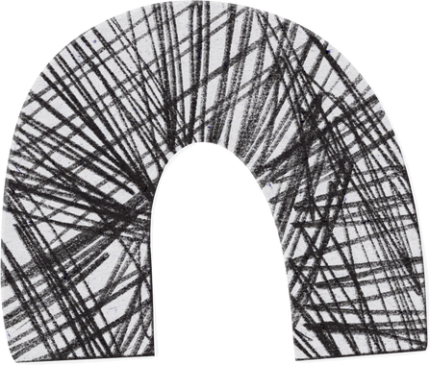
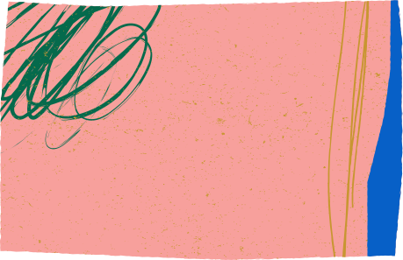

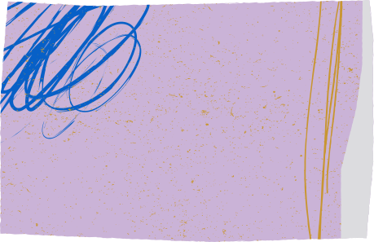
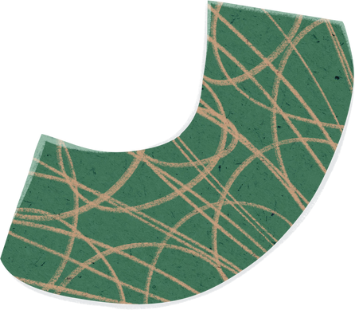

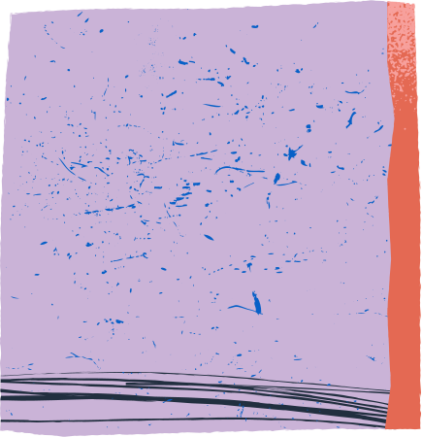
HOW WE DIFFER?
Many IoT greenhouse projects either:
Stop at basic sensor monitoring and relay control, or
Focus only on large industrial setups with complex infrastructure.
There is less focus on a complete, low-cost pipeline that combines:
Real hardware (sensors + actuators)
Cloud database (Firebase)
A modern web dashboard with live health scores and charts
A Unity 3D digital twin that mirrors the real system in real time.
Our project tries to bridge this gap for a small, student-friendly, reproducible setup.

Slide 6
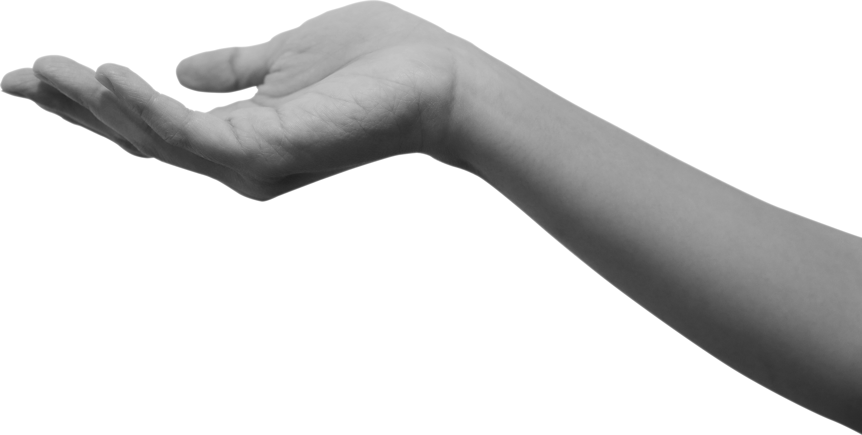
OUR APPROACH
Our approach combines real sensors and actuators with a cloud-connected dashboard and a 3D Unity digital twin.
The Arduino sends live data to Firebase, and both the web dashboard and Unity model update instantly, allowing real-time monitoring and control from anywhere.

Slide 7

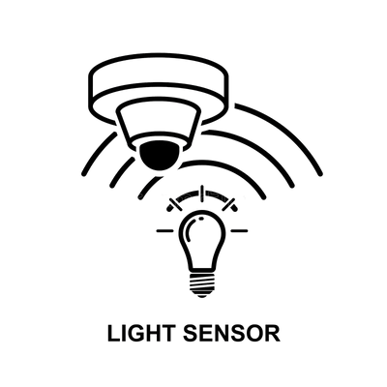
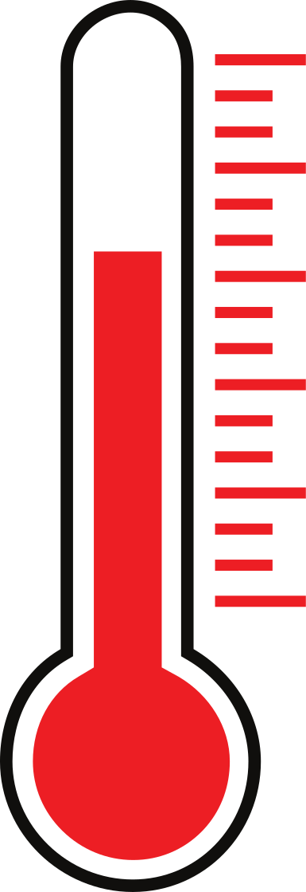

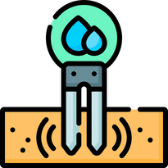


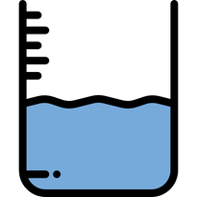
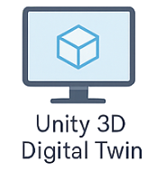






WORKFLOW
Read temperature, humidity, light, soil moisture and water tank fill level
Send values to Firebase Database
Send real-time values to Interface and 3D model
Can control the actuators from 3D model or Interface

Slide 8
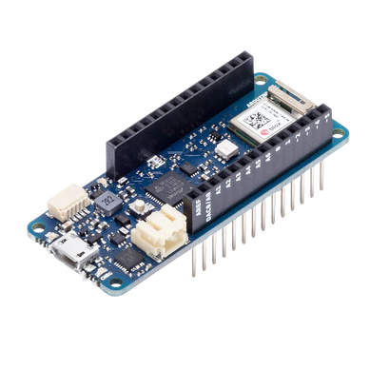
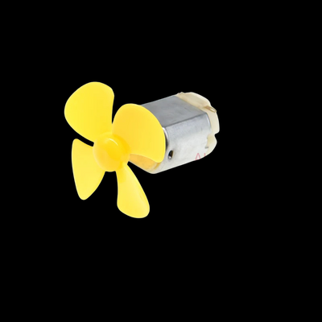



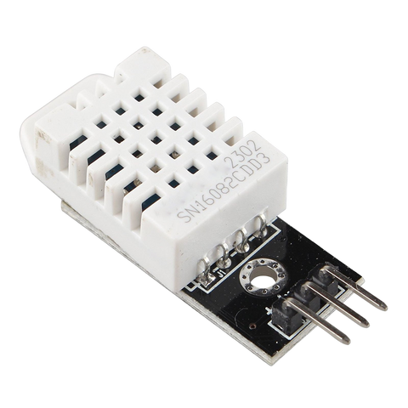
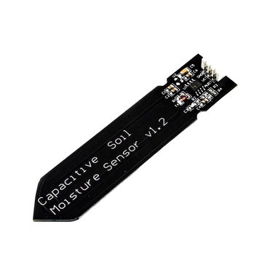
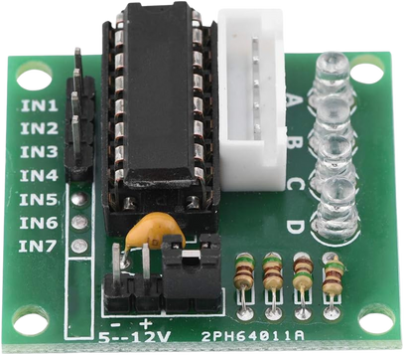
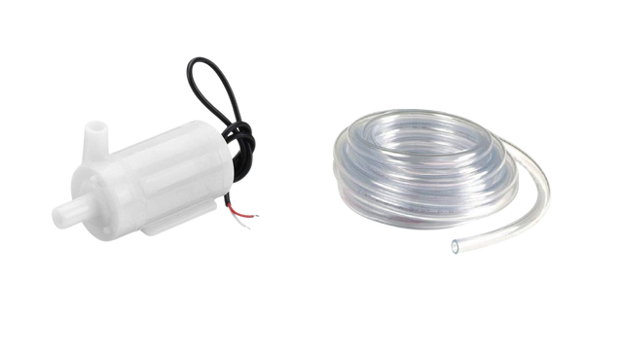
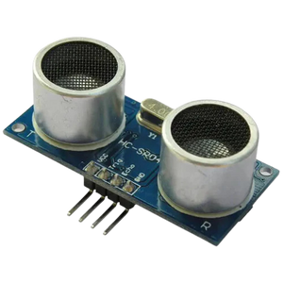

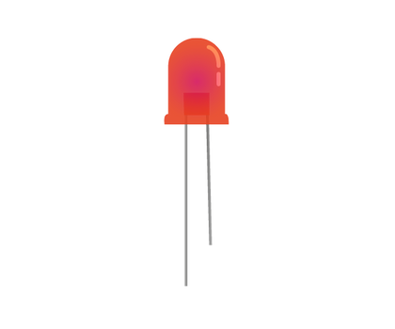
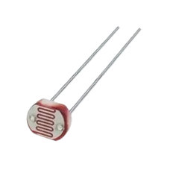

MAIN COMPONENTS
SENSORS
BOARD
ACTUATORS
DHT22
MKR1010
FAN
SOIL MOISTURE
WATER PUMP
MOTOR CONTROLLER
SONAR
LIGHT
LDR

Slide 9
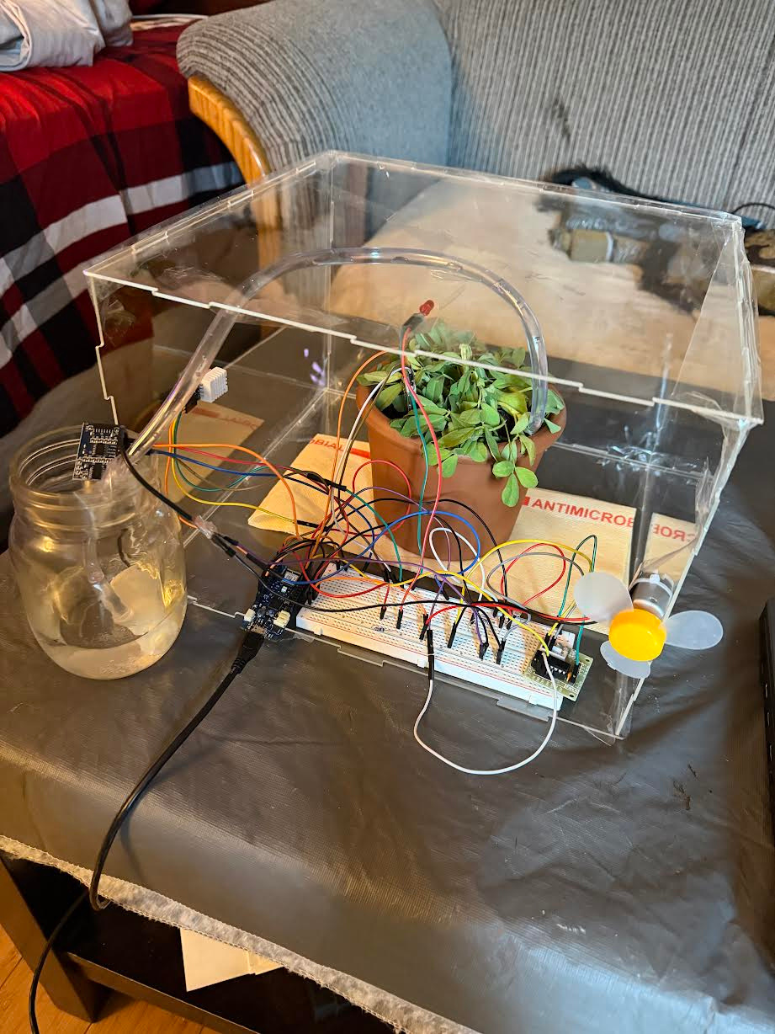
HARDWARE ASSEMBLY
⭐ Notes:
We chose basil plant as they are very sensitive to temperature, humidity, soil moisture, and light — perfect for testing an IoT greenhouse.
In a real greenhouse, this red LED will be replaced with a full-spectrum grow light.
The fan simulates an exhaust system that removes excess heat and humidity.
It demonstrates a full IoT pipeline:
Sensors → Arduino → Firebase → Dashboard + 3D Digital Twin → Actuators

Slide 10
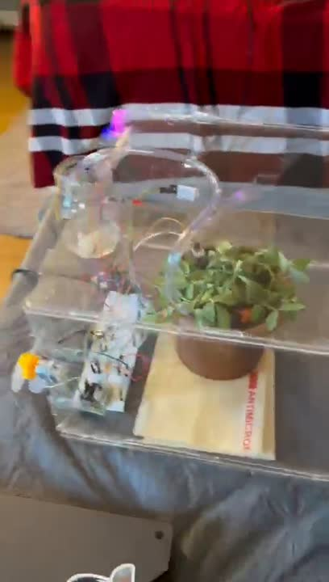
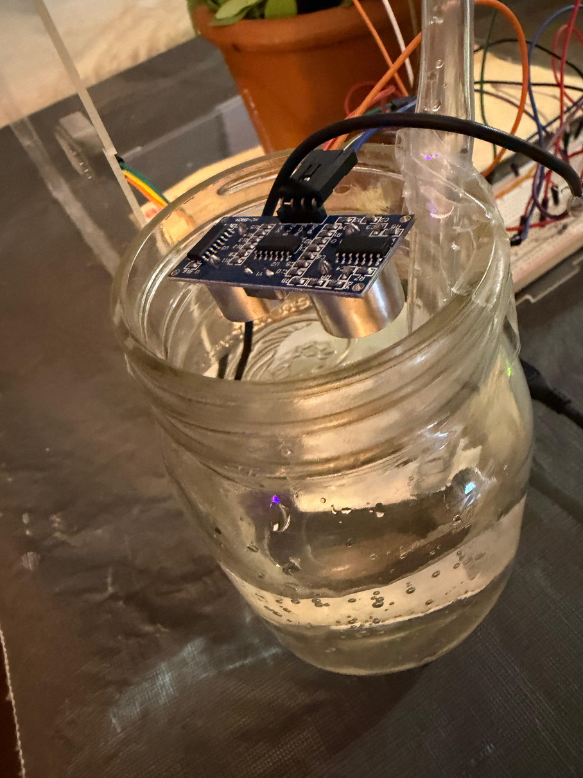
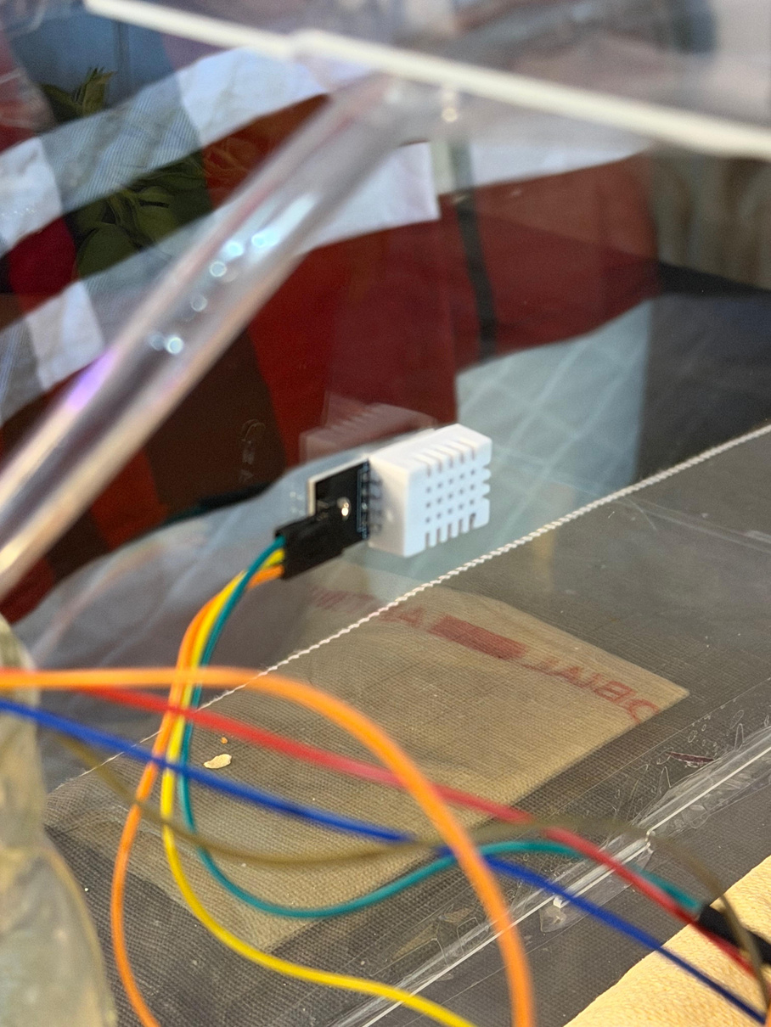
HARDWARE ASSEMBLY
HC-SR04 - to measure the level of water tank fill
DHT22 - to measure the temperature and humidity

Slide 11
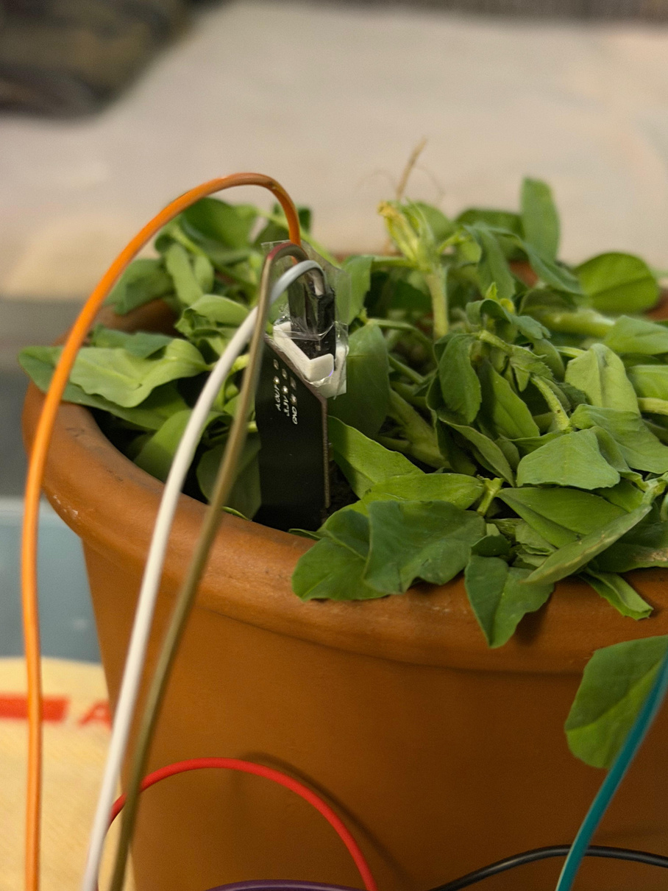
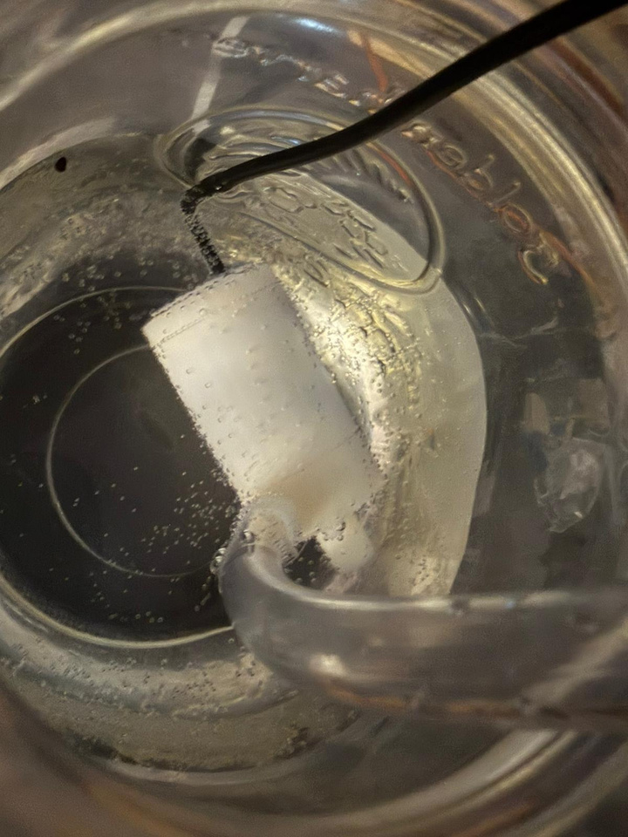
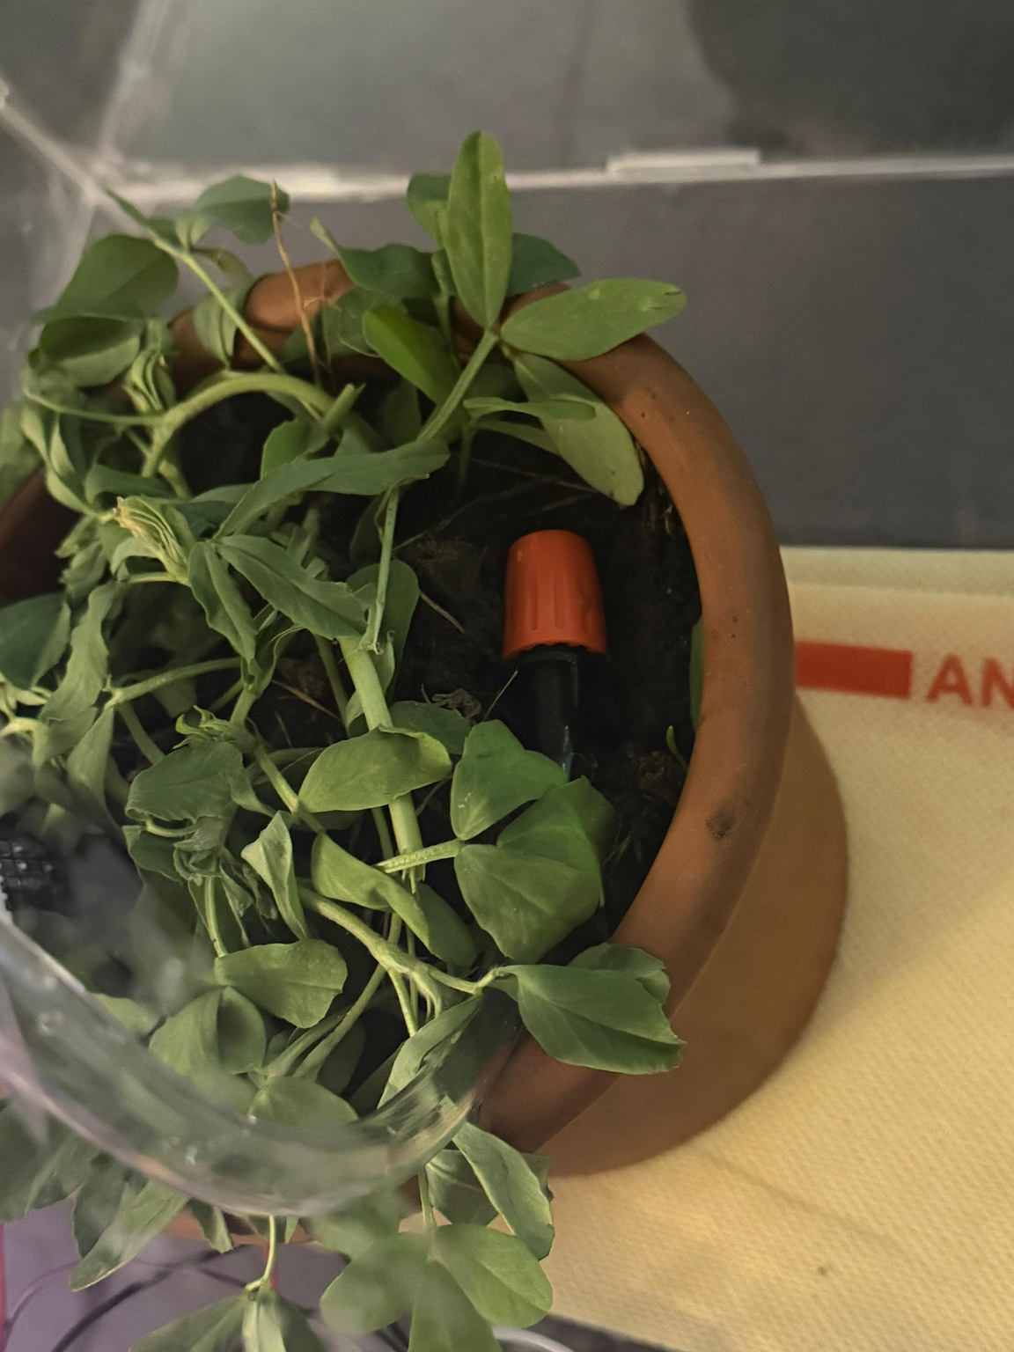
HARDWARE ASSEMBLY
ST0-160 - to measure soil moisture level
DC Submersible Water pump and irrigation kit - to handle watering

Slide 12
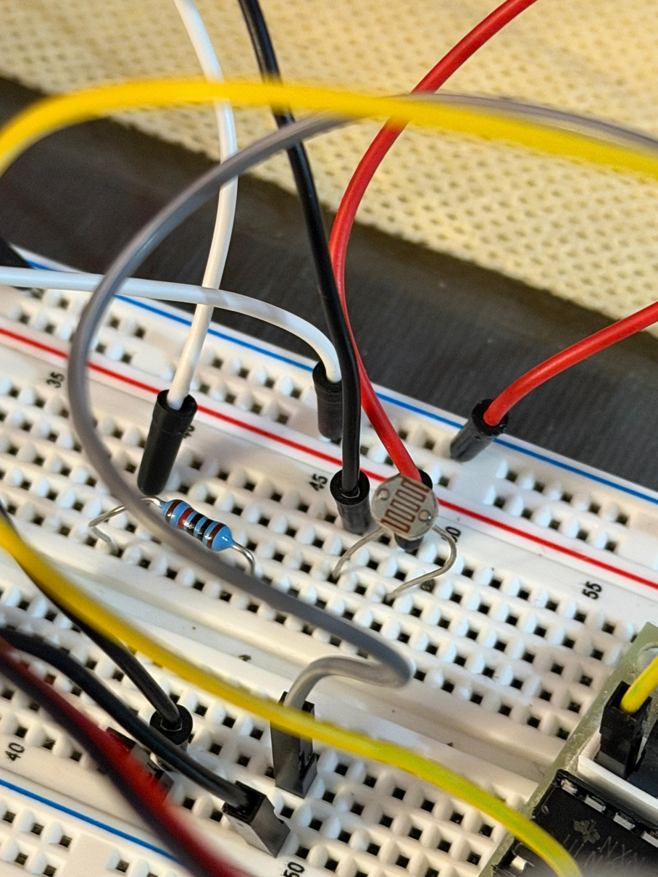
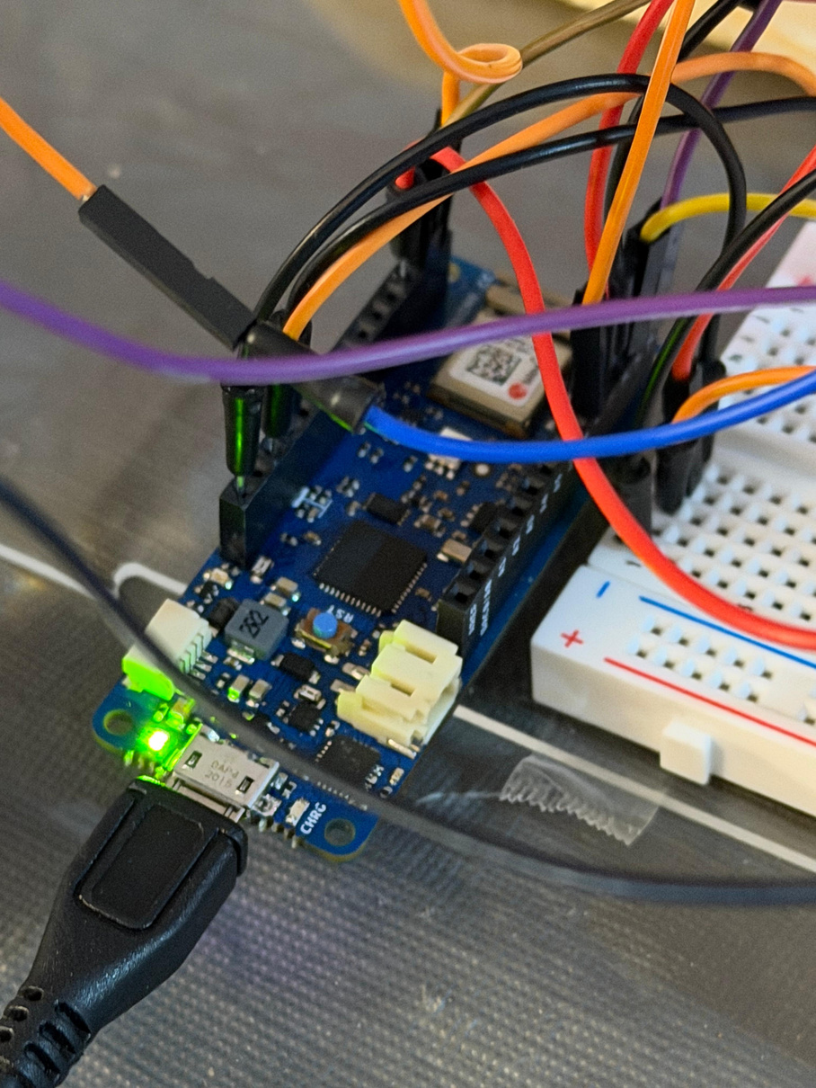
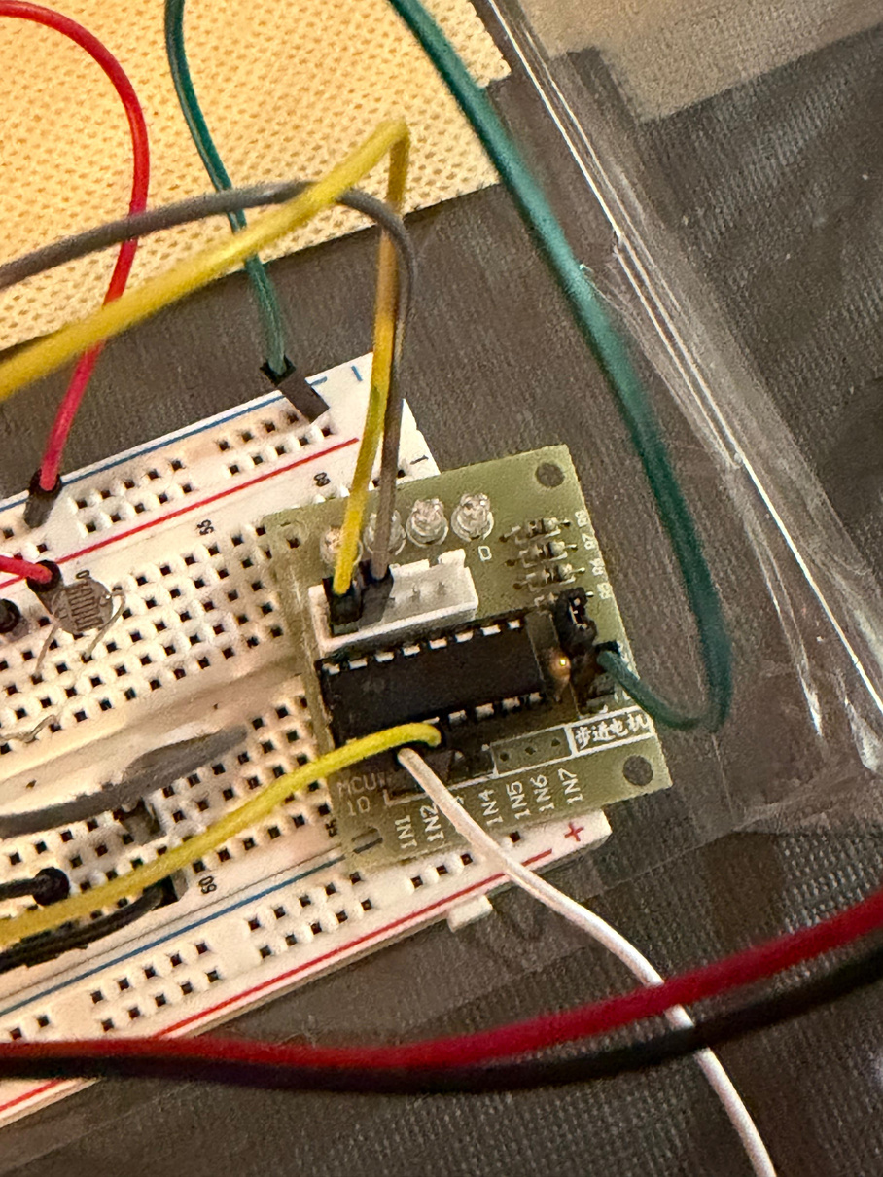
HARDWARE ASSEMBLY
LDR - to measure light intensity
MKR1010 - to act as the main controller or the brain of the system
ULN2003 - to control the motors

Slide 13
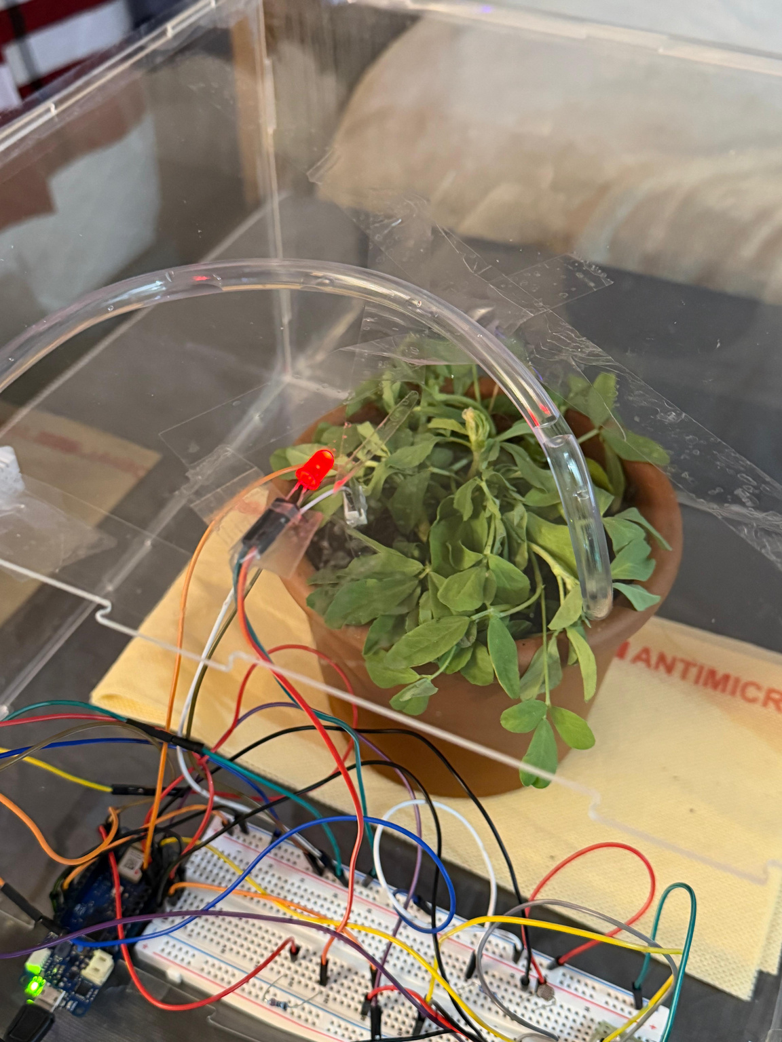

HARDWARE ASSEMBLY
LED - to act as a grow light
DC Fan - to act as exhaust system

Slide 14




HARDWARE
SOFTWARE
Now, let’s move to the software part.
We used :
Arduino IDE to do the hardware coding
HTML, CSS, Javascript to make the interface
Firebase to store real-time data
Unity to make 3D-modeling

Slide 15

Real-time database

Slide 16


Notifications/Tips
Sensor Readings

Slide 17


SENSOR CARDS
Display real-time readings coming from the greenhouse.
Change color (Green / Orange / Red) based on whether conditions are good, warning, or critical.
Each card also shows a status message to help the user understand what the reading means.
TOAST NOTIFICATIONS
Small pop-ups that alert users to warnings or critical events.
Example: “Soil is too dry — consider watering.”
Helps the user stay updated without staring at the dashboard.
HEALTH SCORE
A combined metric (0–100) based on all sensor data.
Gives a quick, easy overview of plant health.
Color-coded bar helps users instantly understand current conditions.
SUGGESTION PANEL (Live Tips)
Provides instant care tips based on sensor readings.
Helps even beginners understand what to fix (e.g., “air too dry,” “soil too wet,” “low light”).

Slide 18

Graphs
Controls

Slide 19


CHARTS/GRAPHS (History View)
Currently the dashboard displays only the last 10 sensor readings to keep the interface fast and lightweight.
In the next phase, this can be expanded to show:
Full-day trends
Weekly or monthly graphs
Downloadable CSV logs
This will allow deeper analysis, such as daily watering patterns, heat cycles, and long-term plant health.
AUTOMATIOIN MODE (Thresholds)
Fan ON: Temp > 30°C or Humidity > 70%
Pump ON: Soil < 40%, tank > 20%, runs max 3 seconds
Grow Light ON: Light < 40%

Slide 20


DEMO:
MANUAL CONTROL OF ACTUATORS FROM DASHBOARD
User can turn on exhaust
User can turn on watering

Slide 21

DEMO:
AUTO CONTROL OF ACTUATORS FROM DASHBOARD
In Auto mode, if humidity percentage is above 70%, the exhaust fan turns on.
To increase the humidity, I turned my humidifier on!
After the humidity drops below 70%, the exhaust automatically turns off.

Slide 22



3D MODEL
Now, let us show you the last part of our project-
3D Digital Twin

Slide 23


Slide 24


Slide 25


DEMO

Slide 26




CHALLENGES
WE FACED
Sensor calibration issues (soil moisture, ultrasonic distance jumping / inconsistent values).
Pump safety logic, requiring an automatic timer to avoid overwatering.
3D digital twin syncing — ensuring Unity received the exact same values without noticeable delay.
Zero experience with Unity and 3D modelling, meaning we had to learn everything from scratch while building the digital twin.

Slide 27


Because our project had limited time and scope, we focused on building a solid working prototype.
If extended further, we could add:
Real grow-light integration instead of a small demo LED.
More sensors and camera-based plant health monitoring.
AI-based predictions for watering and temperature control.
Full historical analytics (daily, weekly, monthly insights + downloadable reports).
Voice assistant integration (Google/Alexa).
Stronger automation using custom rules or ML models.
And many more..

Slide 28









THANK YOU!

